Slide 1
Prelim 1 Review
INFO 4220 – Networks II: Market Design

Slide 2
Announcements
There will be 2 rooms for prelim, please go to the room you were assigned to (will be posted in CANVAS).
PS 1 and 2 grades will be up before Prelim 1.

Slide 3
Format of this review
I will go quickly over the key concepts
  If anything of what I say today sounds unfamiliar, you should review the relevant lecture.
I have a contest with many PollEV questions at the end. Speed and accuracy matters for your final score.

Slide 4
Market Design
We have been solving the same problem in different settings and determining:
Who gets what?
At what price? (if there is a price)
Will agents be “ok” with the mechanism/outcome?
  How are they going to behave before and after the transaction (strategyproofness – stability)?
Is the allocation efficient?

Slide 5
Markets We Studied
Traditional Market Equilibrium
One-to-one matching (musician-singer)
Many-to-one matching (medical match)

Slide 6
Traditional Market Equilibrium
Useful for “thick” markets. When many items are being traded
We think in terms of the supply curve and the demand curve:
  The supply curve tells you how many units producers will make available at a given price
    Depends on their costs of production
  The demand curve tells you how many units consumers will purchase at a given price
    Depends on their consumers’ preferences
We evaluate efficiency of market equilibrium in terms of producer surplus and consumer surplus

Slide 7
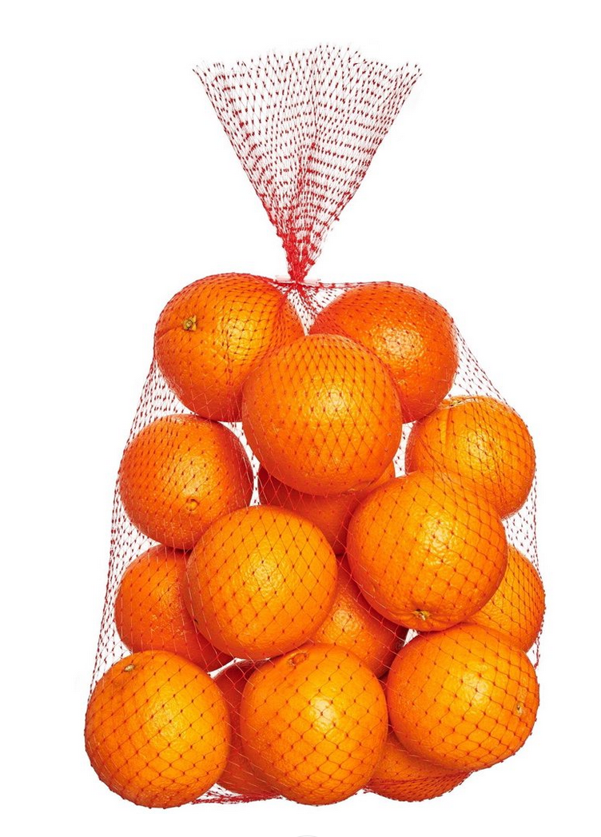







The Demand Curve
$9
$7.5
$5
$4.75
$4.5
$4
$2

Slide 8
Consumer Surplus
Let’s just assume that a bag of oranges costs $5
Consumer Surplus: 4 + 2.5 = 6.5
$9
$7.5
$5
$5
$4.75
$4.5
$4
$2

Slide 9






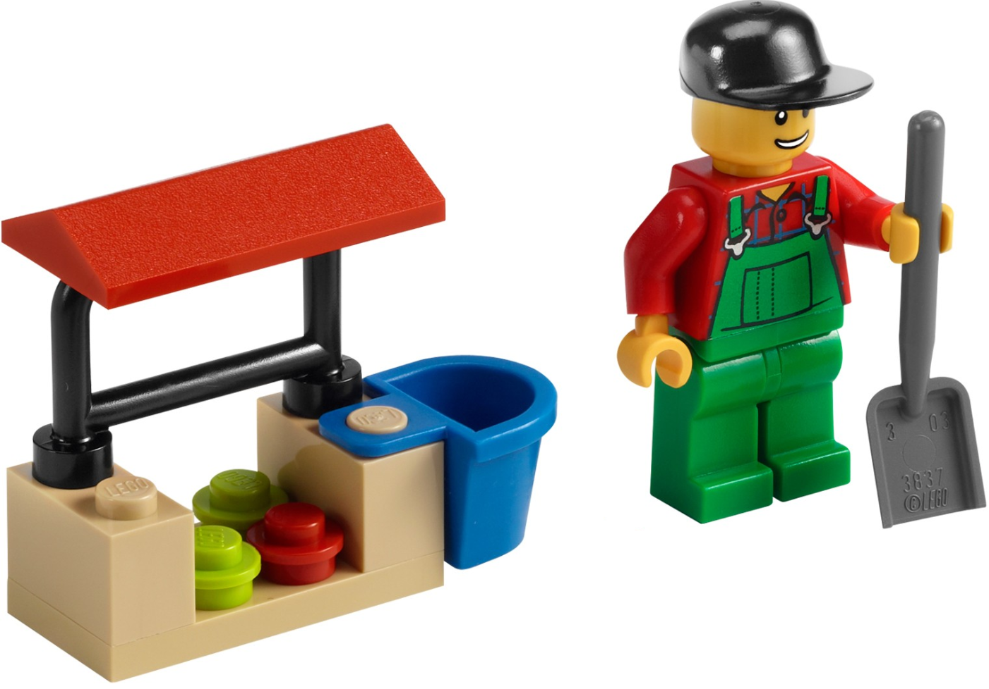
The Supply Curve
$9
$8
$7
$6
$5
$4
$3

Slide 10
Producer Surplus
Let’s just assume that a bag of oranges costs $5
Producer Surplus: 2 + 1 = 3
$9
$8
$7
$6
$5
$5
$2
$1
$4
$3

Slide 11
How are Prices Set
$9
$9
$7.5
$8
$7
$5
$6
$5
$4.75
$4
$4.5
$3
$4
$2
At a price of $5 you have as many sellers as buyers:
If price was higher, there would be more people willing to sell than willing to buy
If price was lower, there would be more people willing to buy than willing sell

Slide 12
Why Did I Explained All This?
Because this is the model of the most typical transactions: Exchanges are coordinated by prices in a perfectly competitive market in equilibrium.
I wanted to show how we evaluate if a market is working well or not: Consumer surplus, producer surplus, total welfare.
And wanted to show how we determine who wins and who looses when we intervene the market in some way:
  Use price ceilings, production caps, taxes, etc

Slide 13





Producer/Consumer Surplus
P
17.5
S
$$CS=\frac{\left(17.5−14\right)∗28}{2}$$
$$Q_{S}(P)=−70+7P⇒P=10+\frac{Q_{S}}{7}$$
$$Q$$
14
$$PS=\frac{\left(17.5−14\right)∗28}{2}$$
D
$$Q_{D}\left(P\right)=140−8P⇒P=17.5 −\frac{Q_{D}}{8}$$
10
28
Q
1. Find equilibrium price, and equilibrium quantity:$Q_{S}=Q_{D}$
$−70+7P=140−8P⇒P=14, { Q}_{S}\left(14\right)=Q_{D}\left(14\right)=$28
2. Find where demand and supply curve intersect vertical axis (Set Q=0 above)
3. Calculate areas corresponding to CS and PS

Slide 14


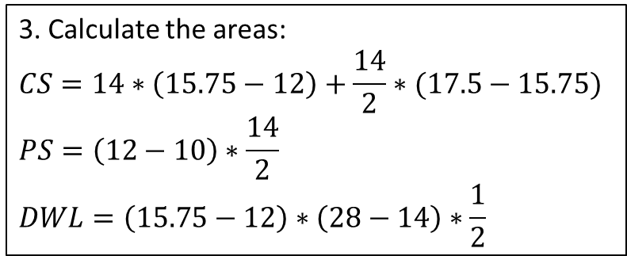


Price Ceiling
(Price can be at most 12)
P
2. Find this point: $P=17.5 −\frac{14}{8}=15.75$
17.5
S
$$Q_{S}(P)=−70+7P⇒P=10+\frac{Q_{S}}{7}$$
3. Calculate the areas:
$$CS=14∗\left(15.75−12\right)+\frac{14}{2}∗(17.5−15.75)$$
$$PS=\left(12−10\right)∗\frac{14}{2}$$
$$DWL=\left(15.75−12\right)∗\left(28−14\right)∗\frac{1}{2}$$
CS
DWL
14
12
PS
D
$$Q_{D}\left(P\right)=140−8P⇒P=17.5 −\frac{Q_{D}}{8}$$
10
28
Q
1. Find this point: $Q_{S}\left(12\right)=−70+7∗12=14$

Slide 15
Game Theory
We talked about Normal Form Games
  Players are rational, know the structure of the game, the rules, and they payoffs of the game
  All the players choose their actions at the same time
(Strict) Dominant actions: The action that maximizes a payer’s profits no matter what all the others players are playing
  Eq. in dominant actions: If all players have one
Nash Equilibrium: An outcome in which no player would benefit from changing their action, provided that all other players do not deviate from their actions

Slide 16
Why Game Theory?
When we are designing a market mechanism, we want to predict how players will behave
In mechanism design we are designing a game such that players behave in a certain way
Whenever we talk about strategyproofness, we are talking about game theory
  Saying a mechanism is strategy proof is saying that revealing once true preferences (or willingness to pay) is a dominant action
When we cannot have strategy proofness we look for mechanisms with a Nash Equilibrium that is good enough

Slide 17
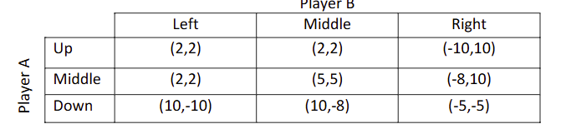
SP22 Prelim 1
Identify all possible equilibrium(s) in dominant actions, identify al possible NE(s), and check if any of the equilibriums are pareto dominated by other outcomes and, if so, why aren’t the pareto superior outcomes an equilibrium?
The best response of A to any action of B is to play down.
The best response of B to any action of A is to play right.
There is one equilibrium in dominant actions: (Down, Right), which is also a NE.
(Down, Right) is pareto dominated by (Up, Left), (Middle, Left), and (Middle, Middle).
While the 3 options above leave both players better off, they cannot be a NE because in each of them a player has an incentive to change their action.

Slide 18
Matching Markets
We then moved to the problem of matching two sets of agents without money
First problem we looked at were singers trying to choose a musician to form a duo (and vice versa)
There is no longer supply or demand:
  We introduce preference orderings
There are no prices to coordinate or quantities sold:
  We introduce a matching function
There is no market equilibrium:
  We introduce the concept of stability

Slide 19
One-to-one matching
How do we define stability:
  Individual rationality
  No blocking pairs
How do we find stable matchings:
  Deferred acceptance algorithm
How will singers and musicians behave when using the deferred acceptance algorithm
  Strategyproof for the side proposing
  Optimality: When singers propose, matching is the singers-optimal matching. When musicians propose, matching is the musician-optimal matching
  Impossible to have strategy proofness for both sides and stability (in general, there may be problems this happens)

Slide 20
Stability
We want to find matchings that are stable
Stable means:
  Individually rational: There is no one that would rather be unmatched
  There are no blocking pairs: You cannot find a pair that would rather be together than with their current match

Slide 21
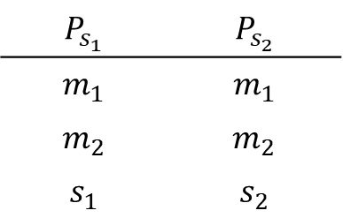
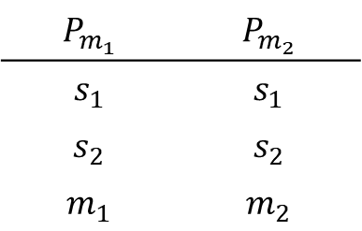
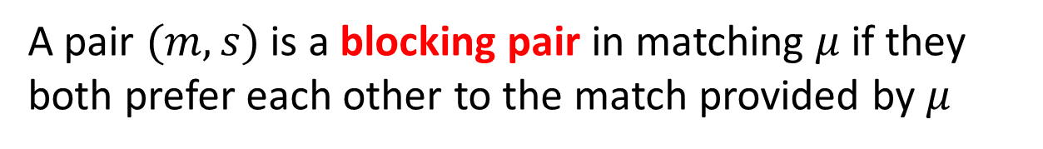
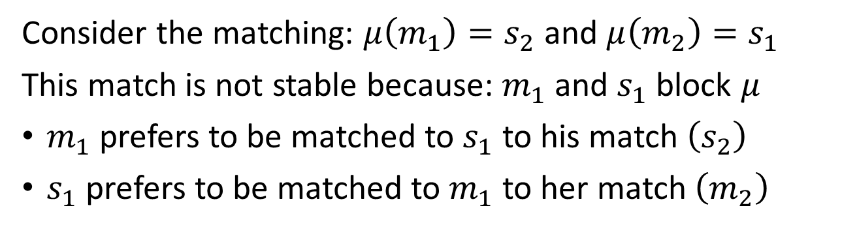
Blocking Pairs
A pair $(m,s)$ is a blocking pair in matching $μ$ if they both prefer each other to the match provided by $μ$
$$P_{m_{1}}$$ | $$P_{m_{2}}$$
$$s_{1}$$ | $$s_{1}$$
$$s_{2}$$ | $$s_{2}$$
$$m_{1}$$ | $$m_{2}$$
$$P_{s_{1}}$$ | $$P_{s_{2}}$$
$$m_{1}$$ | $$m_{1}$$
$$m_{2}$$ | $$m_{2}$$
$$s_{1}$$ | $$s_{2}$$
Consider the matching: $μ\left(m_{1}\right)=s_{2}$ and $μ\left(m_{2}\right)=s_{1}$
This match is not stable because: $m_{1}$ and $s_{1}$ block $μ$
$m_{1}$ prefers to be matched to $s_{1}$ to his match $\left(s_{2}\right)$
$s_{1}$ prefers to be matched to $m_{1}$ to her match $\left(m_{2}\right)$

Slide 22
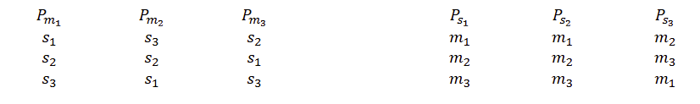
SP22 Prelim 1
In a one-to-one matching problem we have 3 musicians and 3 singers with the following preferences:
Prove if matching is m1-s1, m2-2s, m3-s3 is stable.
We need 2 conditions: individual rationality and absence of blocking pairs.
Individual rationality is trivial, since no musician and no singer would prefer to be unmatched .
There is a blocking pair (m2, s3).
The matching is not stable.

Slide 23
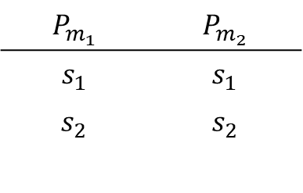
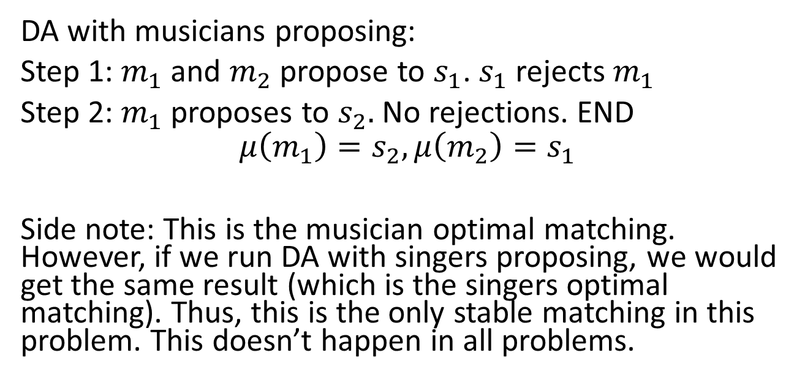
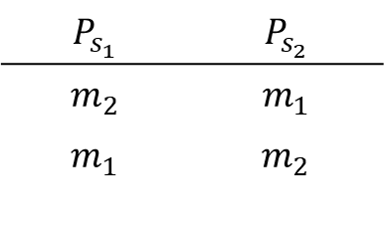
Deferred Acceptance Algorithm
$$P_{m_{1}}$$ | $$P_{m_{2}}$$
$$s_{1}$$ | $$s_{1}$$
$$s_{2}$$ | $$s_{2}$$
$$P_{s_{1}}$$ | $$P_{s_{2}}$$
$$m_{2}$$ | $$m_{1}$$
$$m_{1}$$ | $$m_{2}$$
DA with musicians proposing:
Step 1: $m_{1}$ and $m_{2}$ propose to $s_{1}$. $s_{1}$ rejects $m_{1}$
Step 2: $m_{1}$ proposes to $s_{2}.$ No rejections. END
$$μ\left(m_{1}\right)=s_{2},μ\left(m_{2}\right)=s_{1}$$
Side note: This is the musician optimal matching. However, if we run DA with singers proposing, we would get the same result (which is the singers optimal matching). Thus, this is the only stable matching in this problem. This doesn’t happen in all problems.

Slide 24
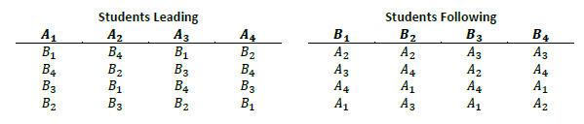
SP24 PS1
In a salsa dancing class, eight students need to pair up to dance salsa. Four students (𝐴1,𝐴2,𝐴3,𝐴4) will lead, and the other four (𝐵1,𝐵2,𝐵3,𝐵4) will follow. Students’ preferences over whom they prefer to dance with are as follows:

Slide 25
SP24 PS1
a) Use DA with “students following” proposing to find dancing partners.
1st round: B1 -> A2, B2 -> A2, B3 ->A3, B4 -> A3. A2 accepts B2, A3 accepts B4.
2nd round: B1 -> A3, B4 -> A4. A2 accepts B1 and A4 accepts B4.
3rd round: B3 -> A2 and is rejected.
4th round: B3 -> A4 and is rejected.
5th round: B3 -> A1 who accepts.
Matching: (A1-B3), (A2-B2), (A3-B1), and (A4-B4).

Slide 26
SP24 PS1
The two teachers decide to join the students to show some new moves. One of them will take a leading role (𝐴5) y the other a follower (𝐵5). They don’t want to have to do the matching process again, so they decide they will start from the current matching (from part a) and 𝐵5 will ask leading students if they want to change their current partner for them. 𝐵5 will propose first to their most preferred “student leading”. If rejected, they next propose to their most preferred students among those they have not proposed yet. When a “student leading” accepts an offer, the “student following” that was matched to them can make a new offer. The following happens: •
𝐵5 proposes to 𝐴1 and is rejected.
𝐵5 proposes to 𝐴2 and is accepted. Now 𝐵2 no longer has a partner and can make a new proposal.
𝐵2 proposes to 𝐴4 and is accepted. Now 𝐵4 no longer has a partner.
𝐵4 proposes to 𝐴1 and is accepted. Now 𝐵3 no longer has a partner.
𝐵3 proposes to 𝐴5 and is accepted. The process ends.
What can we learn about students’ preferences for teachers as dance partners from observing this process? And what can we learn about teachers’ preferences for students as dance partners? Will the matching that results from this process be stable? Why or why not? (Hint: Think on the definition of stability and what you learnt about students and teachers’ preferences) (3 pts)

Slide 27
SP24 PS1
𝐵5 proposes to 𝐴𝐴1 and is rejected.
A1 prefers B3 > B5, but we don’t know about B2.
𝐵5 proposes to 𝐴2 and is accepted. Now 𝐵2 no longer has a partner and can make a new proposal.
A2 prefers B5 > B2, B3, B1, but B5 ? B4.
𝐵2 proposes to 𝐴4 and is accepted. Now 𝐵4 no longer has a partner.
We only learn that B2 prefers A4>A5.
𝐵4 proposes to 𝐴1 and is accepted. Now 𝐵3 no longer has a partner.
We only learn that B4 prefers A1>A5
𝐵3 proposes to 𝐴5 and is accepted. The process ends.
The final matching is: B1 – A3, B2 – A4, B3 – A5, B4 – A1, B5 – A2
It is not stable because there can be a blocking pair. We don’t know anything about the preferences of A5, and we don’t know where A5 stands in the preferences of B1. Thus, it could be the case that B1 is the most preferred for A5, and A5 is the most preferred for B1. If this is the case A5 – B1 would form a blocking pair.

Slide 28
Many-to-one matching
What if one side (hospitals) can be matched to multiple agents from the other side (residents)
We looked at how traditionally hospitals made offers to med students to become residents
  And why it wasn’t working
We saw how we could adapt the deferred acceptance algorithm for these problems
  We had to introduce the concept of responsive preferences
  Now stability will require an additional requirement: Non-wastefulness

Slide 29
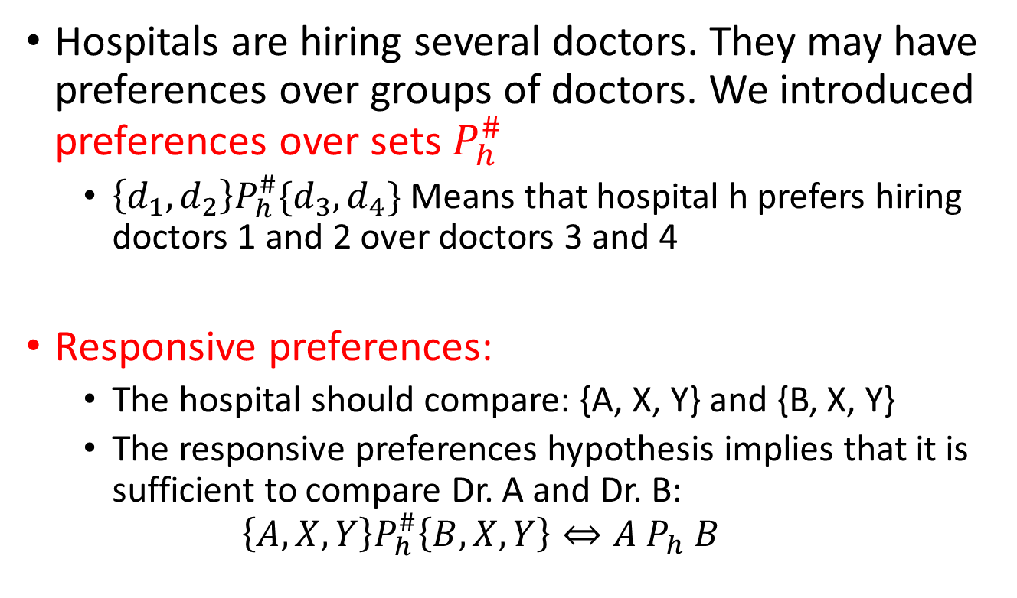
Preferences over sets and responsive preferences
Hospitals are hiring several doctors. They may have preferences over groups of doctors. We introduced preferences over sets $P_{h}^{\#}$
  $\left\{d_{1},d_{2}\right\}P_{h}^{\#}\{d_{3},d_{4}\}$ Means that hospital h prefers hiring doctors 1 and 2 over doctors 3 and 4
Responsive preferences:
  The hospital should compare: {A, X, Y} and {B, X, Y}
  The responsive preferences hypothesis implies that it is sufficient to compare Dr. A and Dr. B:
  $$\left\{A,X,Y\right\}P_{h}^{\#}\left\{B,X,Y\right\}⇔A P_{h} B$$

Slide 30
Stability in many-to-one assignments
Individual rationality:
  No doctor would prefer to be unmatched rather than their current matching
  No hospital is matched to a doctor they consider unacceptable
No blocking pairs:
  You cannot find a pair (d,h) such that d is not matched to h, d would prefer to be matched to h than to its current match, and hospital h would like to change one of the doctors in their matching for d
Non-Wastefulness:
  If a doctor likes hospital h better than their match, then hospital h must be full

Slide 31
Deferred Acceptance in
Many-to One matchings
The DA can be used to obtain a stable matching
The version where doctors propose is similar to the one-to-one version, with the difference that hospitals can hold multiple offers (up to capacity)
In the version where hospitals propose, in the first step a hospital can make as many proposals as spots they have. In subsequent steps, as many proposals as rejections they got in the previous step

Slide 32
NMRP Redesign
We discussed how the NMRP adopted an algorithm that was equivalent to DA with residents proposing
We then discussed strategyproofness of mechanism:
  Yes: If doctors propose
  No: If hospitals propose
And the importance of stability for subsistence of markets
Lastly, we discussed some problems with markets:
  Rural hospitals
  How to deal with couples

Slide 33
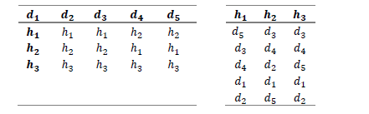
SP 23 Prelim 1
In a medical residence matching program, there are 5 doctors and 3 hospitals. Each hospital has a capacity of 2 doctors. Suppose there are preferences of doctors and hospitals as below:
a) If using the deferred acceptance algorithm in this problem, would you use doctors or hospitals proposing. Explain your choice.
Doctors propose because it is strategyproof and Roth and Pearson determined that it provided fairer outcomes for candidates

Slide 34
SP 23 Prelim 1
b) Use the algorithm you chose in a) to find a solution to this matching problem.
Step 1: D1-> H1, D2 -> H1 (rejected), D3 -> H1, D4 -> H2, D5 -> H2.
Step 2: D2 -> H2, D5 rejected.
Step 3: D5 -> H1, D1 rejected.
Step 4: D1 -> H2, D1 rejected.
Step 5: D1 -> H3.
Final Matching: H1: {D3, D5}, H2: {D2, D4}, H3: {D1, 0}

Slide 35
SP 23 Prelim 1
b) Use the algorithm you chose in a) to find a solution to this matching problem.
Final Matching: H1: {D3, D5}, H2: {D2, D4}, H3: {D1, 0}
c) Is there any stable matching in which hospital 3 fills its vacancies? Explain your answer.
No, because according to the rural hospital theorem, if one hospital does not fill its vacancies in one stable matching, it will not fill them in any stable matching (alternatively, that if a hospital does not fill its vacancies in a stable matching, it is matched to the same set of doctors in all stable matchings).

Slide 36
SP 23 Prelim 1
b) Use the algorithm you chose in a) to find a solution to this matching problem.
Final Matching: H1: {D3, D5}, H2: {D2, D4}, H3: {D1, 0}
After seeing their match, 𝑑1 decides that they would rather be unemployed than accept the match they were assigned to and refuses to work for that hospital (let’s say they quit on the first day). Will the resulting match (after doctor 1 quits) be stable? What if it is 𝑑5 (and not 𝑑1) that quits on day 1?
If 𝑑1 quits, the matching will still be stable 𝑑3 will be empty, but no doctor would like to move to ℎ3 (which wasn’t full to begin with), so the assignment will not be wasteful.
If 𝑑5 quits, the matching will no longer be stable because it will be wasteful since ℎ1 will not be full and 𝑑2 likes ℎ1 better than ℎ2.

Slide 37
Assignment Problems
In matching problems both sides have preferences
How about problems where one side is an object
  We don’t need to care about its “welfare”
  We call this assignment problems
Although objects don’t have preferences, they could have owners: We call it endowment
  Public endowment: Objects belong to everyone
  Private endowment: Objects belong to individuals
  Mixed endowment: Some objects are private, some public

Slide 38
Evaluating Assignments
Individuals have preferences over objects
Objects don’t have preferences:
  But some individuals might have “rights” over objects. We say objects may have a priority ordering over individuals
  Objects can also be free and not have priorities
To evaluate efficiency of an assignment we use the definition of Pareto Efficiency:
  An assignment is Pareto Efficient if there is no other assignment where non is worse off and at least someone is better off.

Slide 39
Matching vs Assignment Problems
In matching problems, we care about the preferences of both side.
  We look for matchings that are stable: Can we find people that would like to be matched to each other (or be unassigned) rather than being with their current match
    Individually rational, No-blocking pairs, Non-wasteful (in many-to-one problems)
In assignment problems, we care about only one side
  We look for assignments that are efficient: Can we find an assignment that would make someone better off without making anyone worse off?

Slide 40
Serial Dictatorship
Simple mechanism and when used in problems without endowments is:
  Efficient
  Strategyproof
  Individually rational
Can also be used in problems with endowments:
  Still strategyproof
  Still efficient
  But someone could end up with an object they like less than their initial endowment. Thus, not individually rational

Slide 41
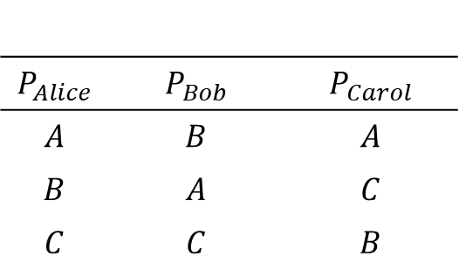
Serial Dictatorship Example
(No endowments)
$$P_{Alice}$$ | $$P_{Bob}$$ | $$P_{Carol}$$
$$A$$ | $$B$$ | $$A$$
$$B$$ | $$A$$ | $$C$$
$$C$$ | $$C$$ | $$B$$
Let’s assume the order of dictators is: Carol, Alice, Bob
Step 1: Carol chooses A
Step 2: Alice chooses B
Step 3: Bob chooses C
This is individually rational, strategyproof, and efficient

Slide 42
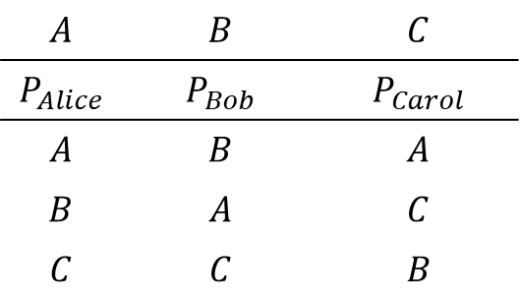
Serial Dictatorship Example
(with endowments)
$$A$$ | $$B$$ | $$C$$
$$P_{Alice}$$ | $$P_{Bob}$$ | $$P_{Carol}$$
$$A$$ | $$B$$ | $$A$$
$$B$$ | $$A$$ | $$C$$
$$C$$ | $$C$$ | $$B$$
Endowments
Let’s assume the order of dictators is: Carol, Alice, Bob
Step 1: Carol chooses A
Step 2: Alice chooses B
Step 3: Bob chooses C
This is strategyproof, and efficient
But is not individually rational, Alice and Bob are worse off

Slide 43
Top Trading Cycle
When there are endowments, the top trading cycle algorithm works better
Algorithm that allow agents to trade objects:
  Efficient
  Strategyproof
  Has the advantage over serial dictatorship of also being individually rational
Theorem: An assignment mechanism is strategyproof, efficient, and individually rational if it uses the top trading cycle algorithm

Slide 44
Prelim SP24
In an assignment problem you need to assign 5 different types of food to 5 animals. None of the animals own any food at the beginning of the problem (i.e. there are no endowments). You decide to use a serial dictatorship to assign the foods. Your friend, who is also enrolled in this class, says that after you run the serial dictatorship you can use the top trading cycle (TTC) algorithm to improve on the assignments in the following way: You run the TTC algorithm considering that the endowment of each animal is the food they were assigned in the serial dictatorship. Prove that your friend is wrong.
Running a TTC after serial dictatorship will not help, because no one would like to trade after the allocation from TTC.
In every step in the serial dictatorship, each animal chose the fruit they preferred among those available. Thus, there will no trades possible in TTC, because:
• Everyone that chose before has a fruit that they like better
• They will not want to trade with anyone that chooses later

